Slide 1
NAIRAS Version 3 Ionizing Radiation Predictions From Ground to Space
Christopher J. Mertens
NASA Langley Research Center
Hampton, VA 23681-2199

Slide 2
Projects/Team Members
Commercial Crew Program (CCP) Post-Flight Reference Radiation Environments (NESC)
NASA LaRC: Chris Mertens, Guillaume Gronoff, Daniel Phoenix
NASA Marshall Space Flight Center: Joe Minow and Emily Willis
NASA Kennedy Space Center: Janessa Buhler
Jet Propulsion Laboratory : Insoo Jun
Community Coordinated Modeling Center (CCMC): Yihua Zheng and Maksym Petrenko
NAIRAS Model Advancements in Nowcasting and Forecasting Aviation Radiation (NASA SWO2R2O)
NASA Langley Research Center (LaRC): Chris Mertens, Guillaume Gronoff, Daniel Phoenix
CCMC: Yihua Zheng and Chinwe Didigu

Slide 3
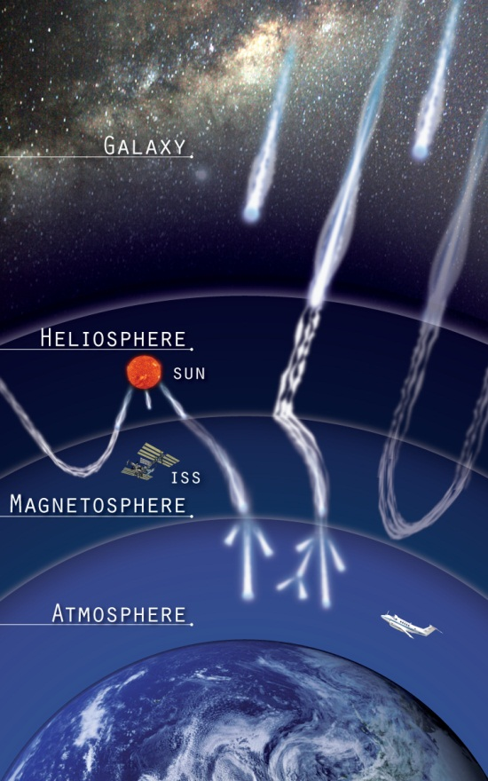
NAIRAS Model
Nowcast of Aerospace Ionizing RAdiation System (NAIRAS) Model
Running in real-time on NASA computer cluster since 2011, aviation radiation results hosted publicly on Space Environment Technologies server/website
Running in real-time at Community Coordinated Modeling Center (CCMC) since 2020
Key (Vintage) Model Features
Physics-based HZETRN (High Charge (Z) and Energy TRaNsport) code
Real-time inclusion of solar energetic particle (SEP) radiation
Real-time solar-magnetospheric effects on radiation (cutoff model by Kress et al. [2004, 2010])
New/Current Model Developments
Extend from atmosphere to space environment, now including trapped protons (TRP-p) and electrons (TRP-e)
SEP heavy-ions (Z=2-92, A=4-238) added
Single-Event Effects (SEE) radiation risk assessment quantities added (differential/integral flux/fluence)
Run-on-Request (RoR) @ CCMC (search NAIRAS CCMC)

Slide 4
Real-Time NAIRAS @ CCMC
CCMC Integrated Space Weather Analysis (iSWA) System

Slide 5
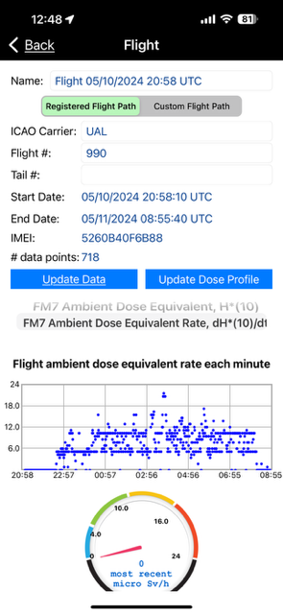
SEP Event: May 11-13 2024
NAIRAS Effective Dose Rate 11 km
Credit: Kent Tobiska

Slide 6
SEP Event: May 11-13 2024
At commercial aviation altitude (11 km), the effective dose rate was slightly less than pre-storm due to Forbush decrease
At business jet altitudes (15 km), the effective dose rate was briefly doubled to 15 uSv/h (12-13 UT on May 11)
The free-space effective dose rate (40 km as proxy) was enhanced by over an order of magnitude
Real-time global dose products at 20 km recently added to support US Space Force military high-flyers. SEP effective dose rate enhancement was factor 2-3.
NAIRAS Effective Dose Rate 20 km

Slide 7
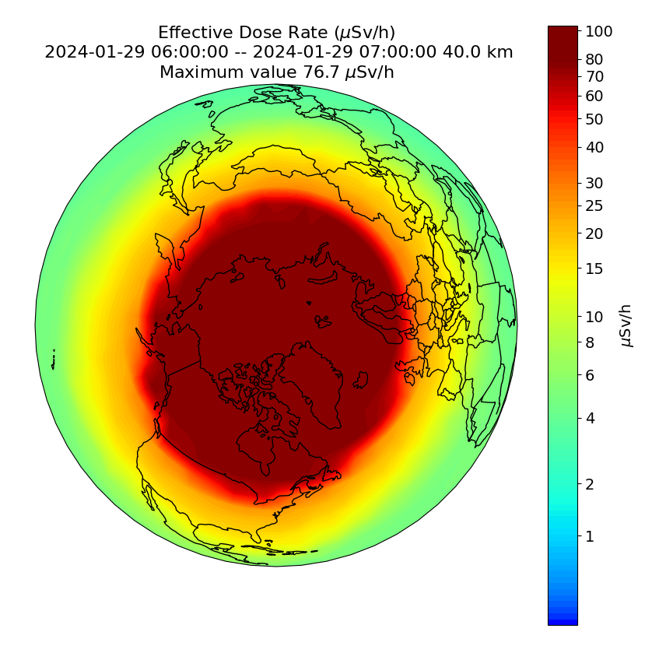
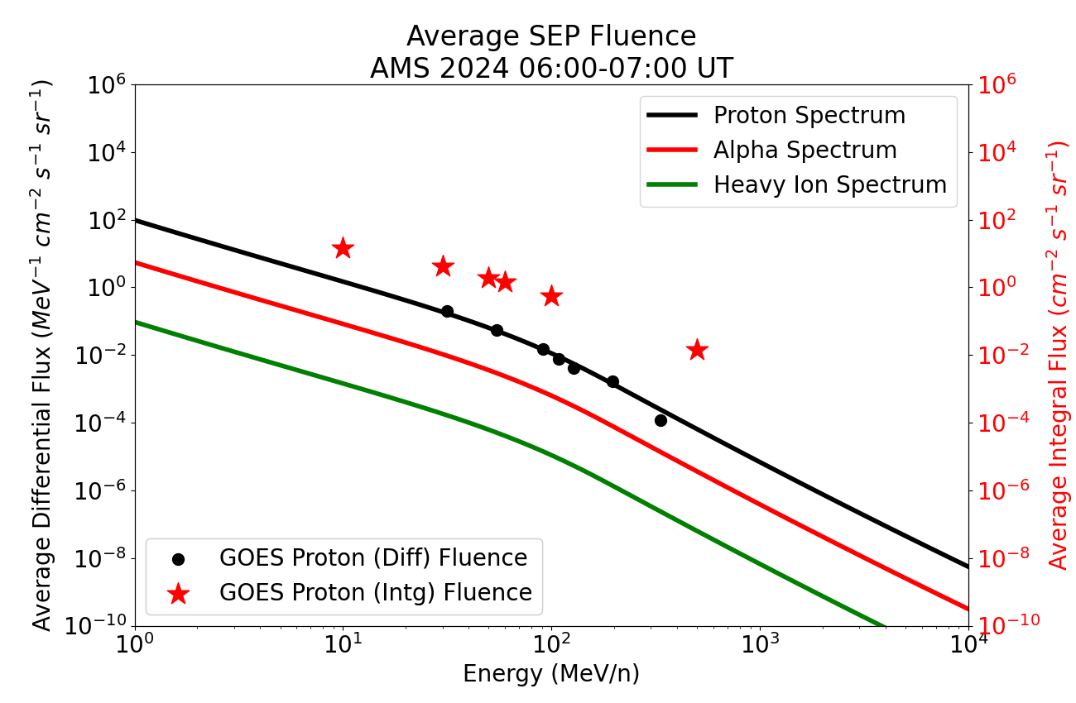
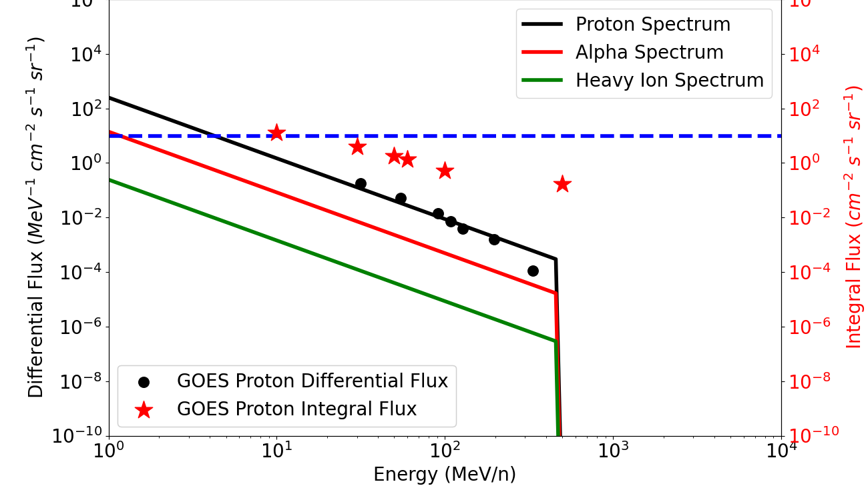
NAIRAS Real-Time Predictions (2/9/24)
GOES >500 MeV Background Subtract

Slide 8
GCR Contributions to >500 MeV Flux

Slide 9
GCR Contributions to GOES >500 MeV Channel

Slide 10
NAIRAS Run-on-Request (RoR) User Input
Table: RoR Capability Summary and Description
Run Option | Output Quantities |  | User Input
Global Dosimetric | Absorbed dose in silicon, absorbed dose in tissue, dose equivalent, ambient dose equivalent, effective dose |  | Start/End Date-Time
Flight Trajectory | Dosimetric & Flux/Fluence |  | Trajectory file
 | Dosimetric | Same as global run | Shielding depths for dosimetric calculations
 | Flux/Fluence |  | Shielding depths for flux/fluence calculations
 |  | Integral GCR/SEP LET (linear energy transfer) SEP proton TRP-p proton TRP-e electron | Lower LET/energy bounds of integral quantity
 |  | Differential GCR/SEP/ LET (linear energy transfer) TRP-(p/e) LET SEP proton TRP-p proton TRP-e electron | N/A (full model differential spectra written to output)

Slide 11
NAIRAS/ARMAS Comparisons (45 Flights 2022-23)
Mean Dose | Si Dose (µGy/h) | Ti Dose (µGy/h) | Dose Eq. (µSv/h) | Ambient Dose ($µ$Sv/h) | Effective Dose ($µ$Sv/h)
ARMAS | 2.8 | 4.1 | 8.5 | 13.1 | 17.7
NAIRAS | 3.0 | 3.7 | 8.3 | 10.4 | 11.9
Difference (%) | 8.27 | -9.29 | -2.35 | -20.97 | -33.05
Median Dose | Si Dose (µGy/h) | Ti Dose (µGy/h) | Dose Eq. (µSv/h) | Ambient Dose (µSv/h) | Effective Dose (µSv/h)
ARMAS | 2.8 | 4.2 | 8.6 | 13.3 | 17.8
NAIRAS | 3.1 | 3.8 | 8.0 | 10.5 | 11.9
Difference (%) | 7.39 | -9.62 | -6.94 | -21.14 | -32.85
Phoenix et al. (2024), Space Weather

Slide 12
NAIRAS/ARMAS ISS Comparison (Oct 6, 2022)
Trapped electrons?
Trapped electrons added

Slide 13
NAIRAS/Liulin ISS Comparison (June 2015 SEP)
Liulin dosimeter outside ISS on ESA EXPOSE-R2 Platform
Al Shielding: 0.8 g/cm²

Slide 14
NAIRAS/REACH Comparisons (2/10/2018)

Slide 15
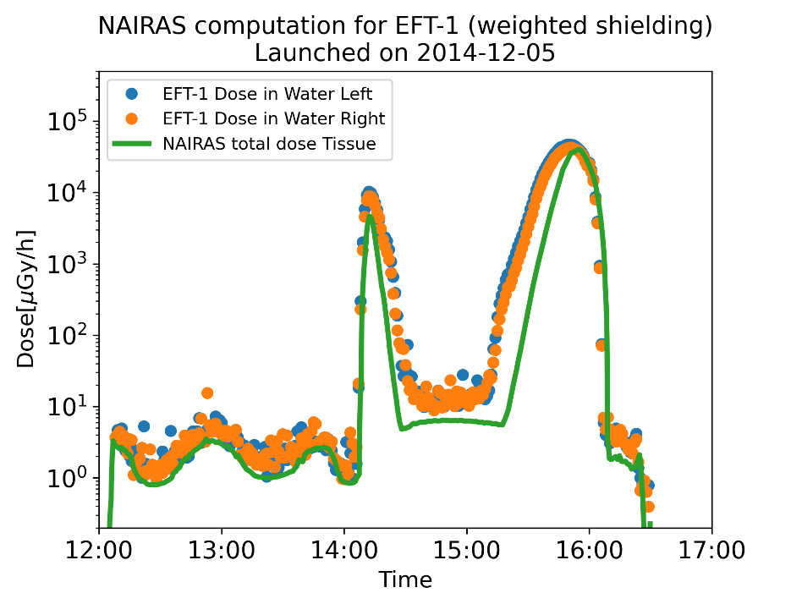
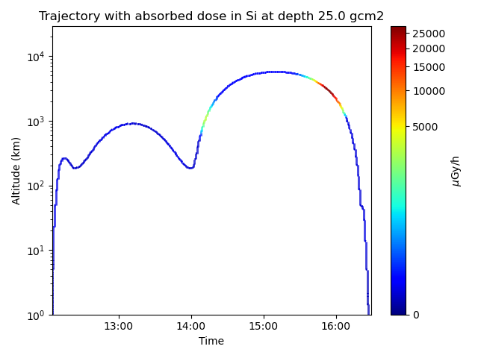
NAIRAS/BIRD Comparison on NASA EFT-1 Flight
NASA Orion Exploration Flight Test-1 (EFT-1)
Unmanned flight of NASA Orion Multi-Purpose Crew Vehicle (MPCV)
Orbital inclination: 28.6 degree
Battery-operated Independent Radiation Detector (BIRD)
Two BIRD active semiconductor detectors (called Left/Right): Timepix technology
Data analysis algorithm converts dose in silicon to dose in water (proxy for tissue)
NAIRAS/BIRD Comparison
NAIRAS underestimates BIRD by 60% in GCR region (before 14 UT) and TRP region (later than 14 UT)
BIRD overestimates total flight dose of other onboard dosimeter systems by 20%.
Considering BIRD biased by 20%, NAIRAS underestimates BIRD by 40%
NAIRAS uncertainty for GCR known to be within 30%

Slide 16
Summary and Conclusions
New NAIRAS Real-Time Aviation Radiation
New dosimetric products at 20 km for military high-flyers
Under development: customized pilot interface
New NAIRAS RoR Capability
Global dosimetric run option: context and situational awareness
Flight trajectory run option: detailed human flight radiation exposure characterization, detailed comparisons with onboard dosimeters, provide inputs to radiation effects models to assess SEE in aircraft and spacecraft flight electronics
NAIRAS agrees with measurements to within 30% from 0-40 km
NAIRAS aircraft radiation validation (Phoenix et al (2024), Space Weather)
NASA Radiation Dosimetry Experiment (RaD-X) campaign: manuscript in preparation
NAIRAS comparisons with measurements in the space environment are encouraging (generally less than 60%)
ISS low-Earth orbit (LEO)
First SEP event validation is excellent (LEO)
NASA EFT-1 medium-Earth orbit (MEO)
NASA Artemis-1 Mission (cislunar)
SEP Dose Forecast Development
UMASEP-NAIRAS coupling for SEP proton spectrum forecast
Under development: preliminary results encouraging

Slide 17
Backup Slides

Slide 18
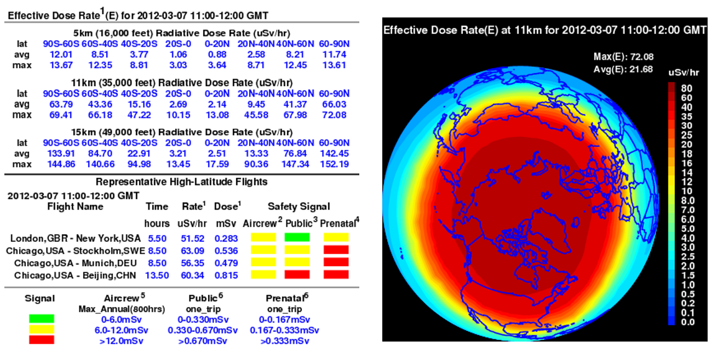
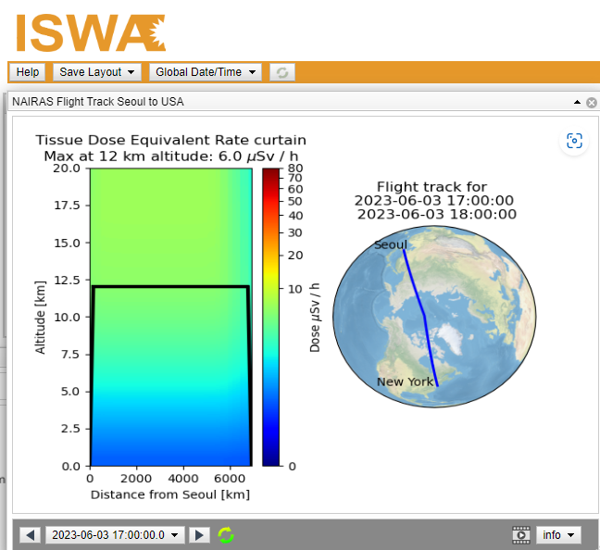
In Development: Aviation Pilot Interface
Graphical and tabular output products from NAIRAS version 1 (ca. 2013).
Altitude variation of dose rate along aircraft flight from NAIRAS version 3 @ iSWA
Aviation Pilot Interface: Combine old and new features
User input: city-pair location + depart/arrive datetime + cruise altitude
Custom graphical/tabular output (similar to above)
Flight levels at which ICAO dose threshold levels are exceeded

Slide 19
Jenn Gannon Superstormof 2024 (May 11-13)
NAIRAS Effective Dose Rates at 40 km

Slide 20
GOES Integral Flux Measurements (May 2024)

Slide 21
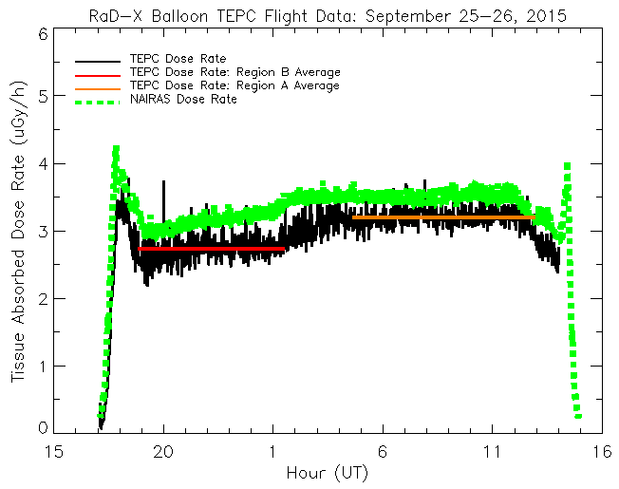
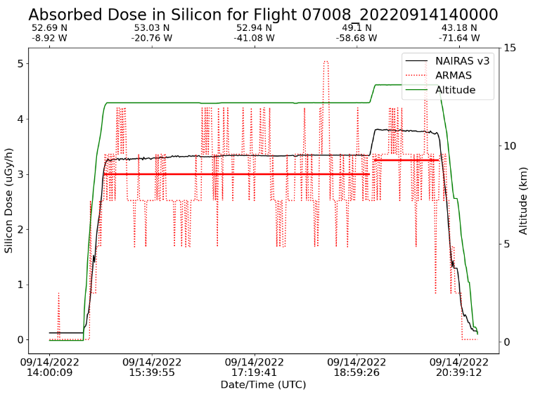
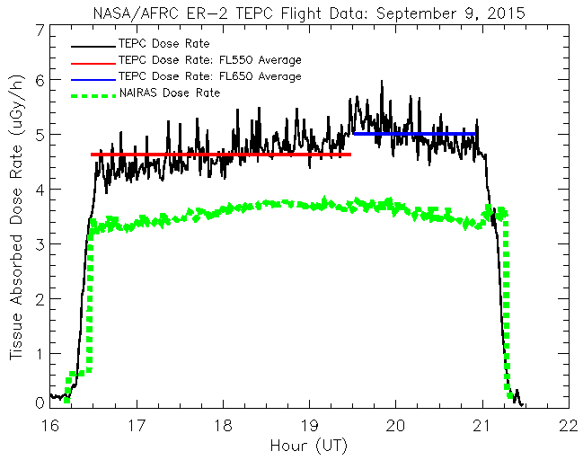
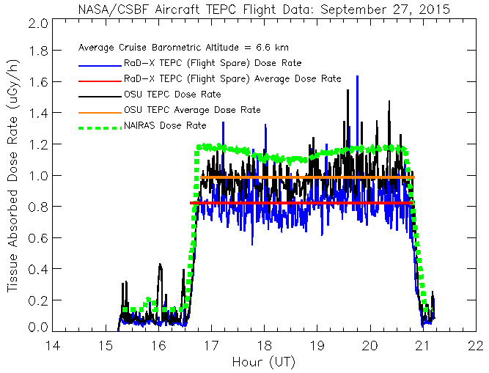
NAIRAS Validation @ 0-40 km
RaD-X Region A: 21 km < Z < 27 km; Region B: Z >32.5 km
US Corporate Aircraft: EINN-KBDL
Legend
NASA Radiation
Dosimetry Experiment (RaD-X)
Automated Radiation Measurements for Aerospace Safety (ARMAS) semiconductor dosimeter
Columbia Scientific Balloon Facility (CSBF)
Tissue equivalent proportional counter (TEPC)
Absorbed dose rate comparisons
Tissue (top left, bottom left, bottom right)
Silicon (top right)
Agreement within 30%
RaD-X ER-2: Z = 17km, 20km
RaD-X CSBF Chase Plane: Z = 6.6 km

Slide 22
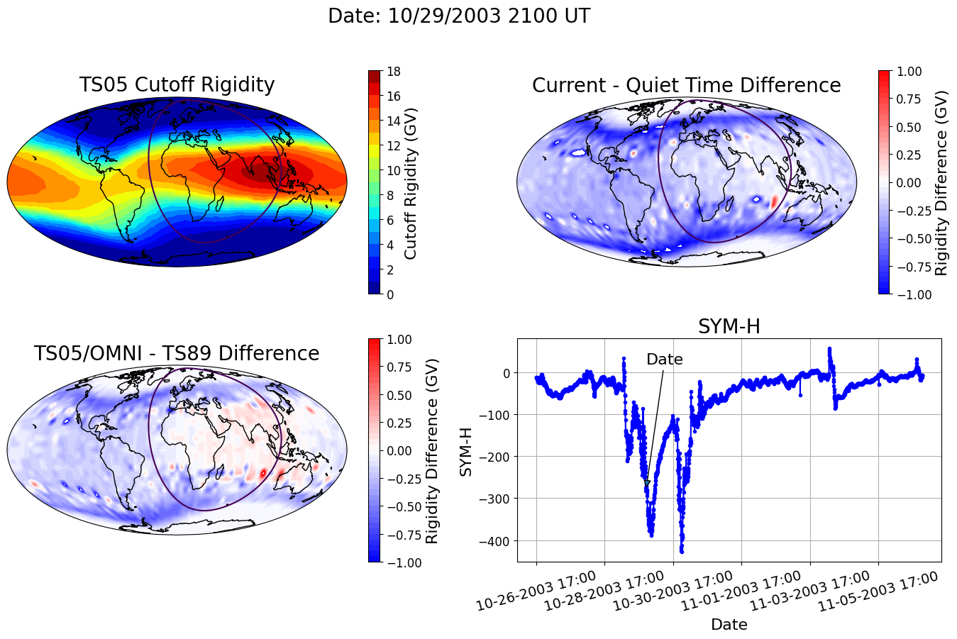
Geomagnetic Cutoff Rigidity Model
Based on CISM-Dartmouth model with TS05 magnetospheric B-field (Kress et al., 2010)
Added multiple magnetospheric B-field selection capability
TS05 → parameterized by solar wind quantities, interplanetary magnetic field (IMF), SYM-H/Dst, and other derivative solar wind quantities
T89 → parameterized by the planetary K-index (Kp)
The TS05 better represents magnetospheric responses to interplanetary disturbances
but real-time solar wind parameters available from ACE/DSCOVR 1995+
Benefits of T89 option
NAIRAS can simulate any historical solar-geomagnetic storm event
Extend/enhance validation capabilities
Provide initial step in forecasting cutoff via Kp-parameter forecast
Halloween 2003 Geomagnetic Storm
Top Right: Largest suppression of cutoff (~1 GV) (open-closed field boundary) occurs in dusk sector due to max build-up of partial ring current in TS05 (IMF Bz dependent)
Bottom Left: T89 doesn’t well represent max cutoff
suppression and cutoff in dusk sector

Slide 23
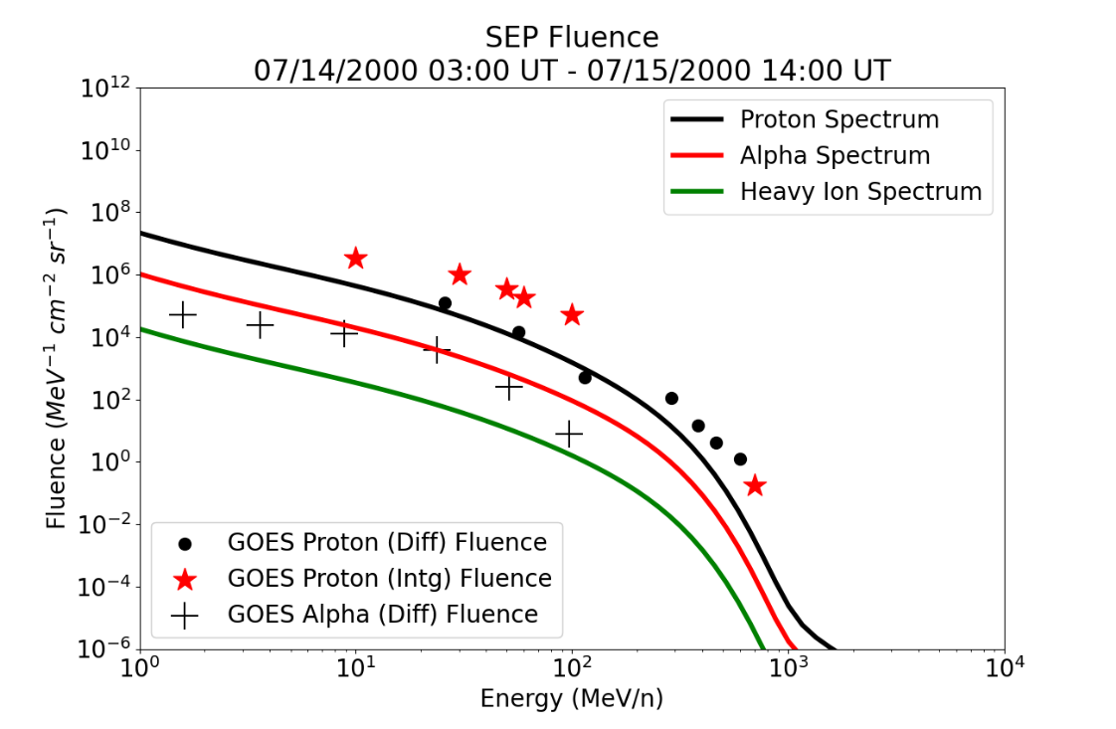
NAIRAS SEP Spectral Fitting
Bastille Day SEP Event Fluence
Protons
Fit spectrum to GOES integral proton flux
Fit four functional forms
Choose solution with minimum chi-square
Alpha
Retain proton spectral shape from previous step
Scale proton spectrum by optimal normalization factor using GOES alpha differential flux
Heavy-Ion (Z > 2)
Scale alpha spectrum from previous step using element/alpha abundance ratios
Major heavy-ion abundance ratios: using GOES alpha and ACE Solar Isotope Spectrometer (SIS) element flux measurements (Xapsos et al., 2007)
Minor heavy-ion abundance ratios: using ACE/SIS and International Sun-Earth Explorer-3 (ISEE-3) element flux measurements (Reames, 1998)
Remaining heavy-ion abundance ratios: using photospheric emission measurements with a scale factor of 4 if the first ionizing potential is less than 10 eV (Grevesse, 2019)
SEP proton spectrum fit to GOES integral proton flux. GOES differential proton flux shown for comparison.
SEP spectra fit to GOES 5-min data. Fluence is 5-min fitted-spectra summed over event.

Slide 24
SEP Heavy-Ion Effective Dose in LEO (ISS-like)
Event Selection: 10 largest SEP events with respect to free-space event dose (Minow et al., Space weather architecture options to support human and robotic deep space exploration, NASA Langley Research Center, Hampton, VA, USA, Tech. Mem. TM/2020-5000837, Apr. 2020.)
Take Away 1: 4 of 10 events SEP heavy-ions increase effective dose by > ~ 40% (red) at 50 g/cm²
Take Away 2: Nearly all events SEP heavy-ions increase effective dose by factor 2-3 at 2 g/cm² (EVA)

Slide 25
SEP Heavy-Ion Model

Slide 26
NAIRAS LEO LET: Halloween 2003 SEP Event
Differential and Integral LET Quantities
Nov 02, 2003 16:00 UT - Nov 03, 2003 16:00 UT
Al Shielding: 4 g/cm²

Slide 27
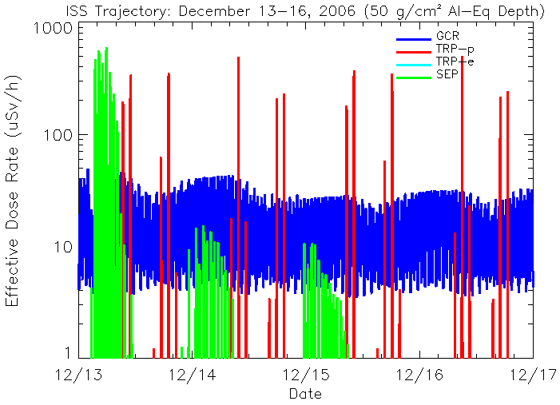
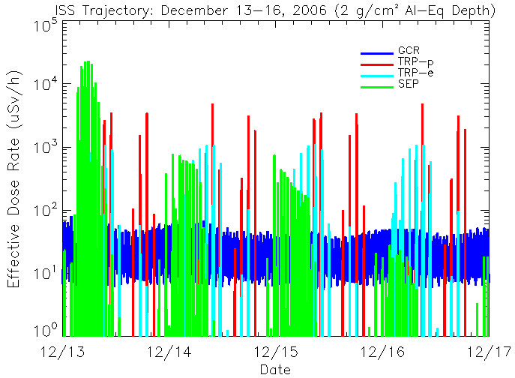
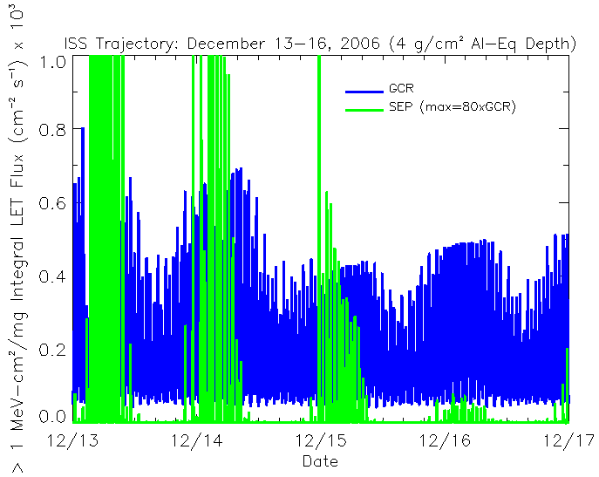
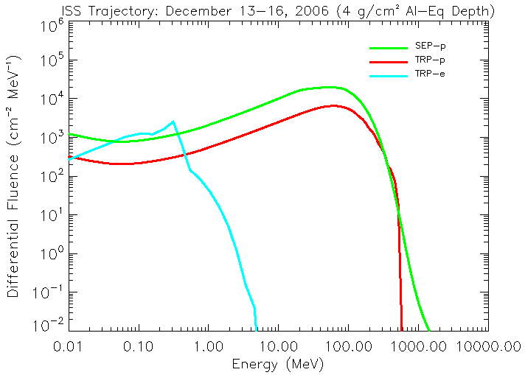
Dec 2006 SEP Events: ISS Radiation
Al Shielding: 50 g/cm² (internal vehicle)
Al Shielding: 2 g/cm² (EVA)
Al Shielding: 4 g/cm² (SEE)
Al Shielding: 4 g/cm² (SEE)

Slide 28
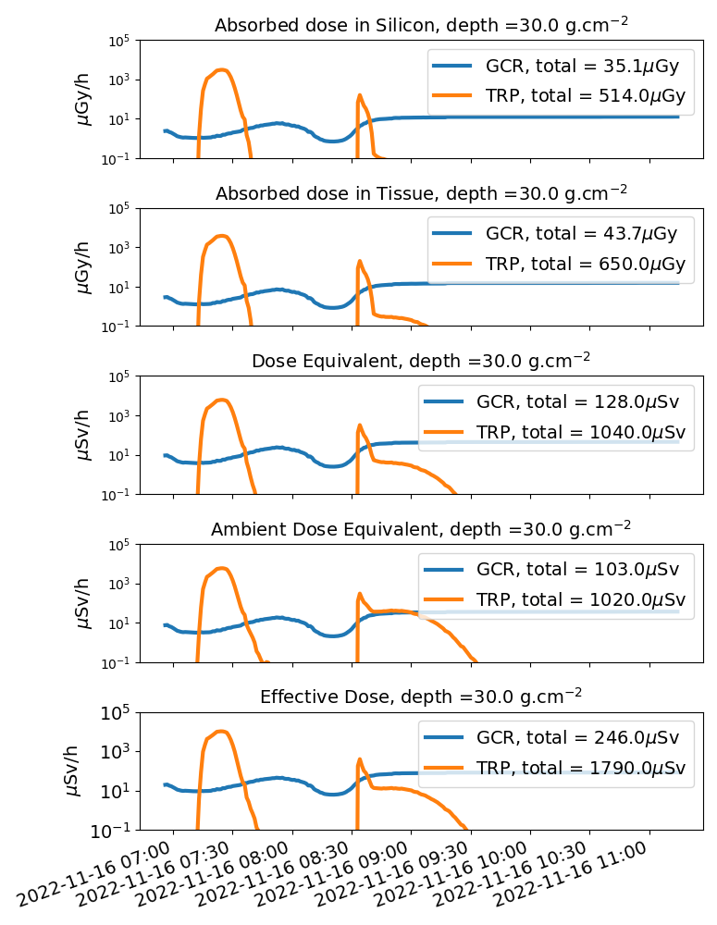
NAIRAS Dose: NASA Artemis-1 Mission
November 16, 2022
NAIRAS Free-Space Dose Rates (30 g/cm²)
Absorbed dose in silicon: 12-13 uGy/h
Effective dose: 80 uSv/h

Slide 29
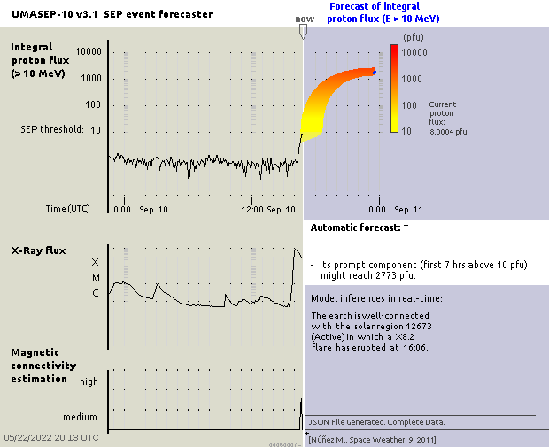
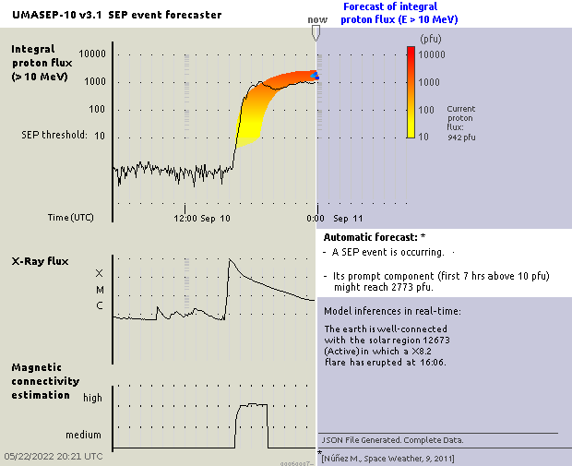
UMASEP Forecast: September 2017
Example Below: >10 MeV Peak Integral Proton Flux
Forecast Issue Time 09/10/2017 16:40 UT
Forecast Window: Issue Time + 7 hours
Other UMASEP Peak Integral Proton Flux Forecast Products: >50 MeV, >100 MeV, >500 MeV

Slide 30
UMASEP-NAIRAS SEP Forecast
7 hours after UMASEP >10 MeV integral proton flux forecast issue time

